Slide 1
Threads In .net
Parallel programming, March 2019

Slide 2
agenda
parallel programming Concepts
tools
Task parallel library (TLP)
Parallel structures
(parallel.for and parallel.foreach)
plinq

Slide 3
agenda
parallel programming Concepts
tools
Task parallel library (TLP)
Parallel structures
(parallel.for and parallel.foreach)
plinq

Slide 4
Parallel programming concepts
Distribute charges
+ CPU cores= + threads executing simultaneously.
Before was called: Multi-Thread programming
In the past parallelization required low-level manipulation of threads and locks.
Actually there is not direct manipulation of threads.

Slide 5
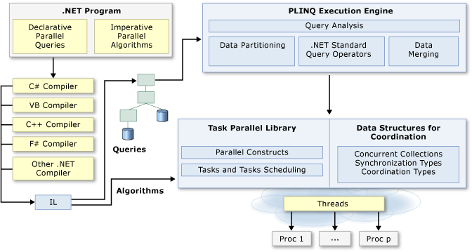
Parallel programming concepts
Parallel programming (high level)

Slide 6
Thread Types
Foreground:
Keep the application alive for as long as they are running.
When completed, the application ends and any background threads terminate immediately.
By default, threads that are explicitly created are foreground threads
Background:
Threads that are terminated automatically when all the foreground threads are closed are completed.
Created by setting the IsBackground property to true
IsBackground can be used to change a thread´s status
Excellent for tasks like polling services or logging info

Slide 7
agenda
parallel programming Concepts
tools
Task parallel library (TLP)
Parallel structures
(parallel.for and parallel.foreach)
plinq

Slide 8
tools
Task Parallel Library - TPL:
Simplifies the process of adding parallelism and concurrency to applications.
Parallel Language-Integrated Query - PLINQ:
Is a parallel implementation of LINQ, faster in terms of parallel operations

Slide 9
agenda
parallel programming Concepts
tools
Task parallel library (TLP)
Parallel structures
(parallel.for and parallel.foreach)
plinq

Slide 10
Task parallel library (TLP)
The TPL scales the degree of concurrency dynamically to most efficient use all the processors that are available
The TPL handles the partitions of the work, the scheduling of threads on the ThreadPool, cancelation support, state management and other low-level details.

Slide 11
Task parallel library (TLP)
The TPL started in .NET framework 4.
Not all code is suitable for parallelization.
The TPL maximizes the performance of your code.

Slide 12
agenda
parallel programming Concepts
tools
Task parallel library (TLP)
Parallel structures
(parallel.for and parallel.foreach)
plinq

Slide 13
Parallel structures
Parallel.for
Parallel.foreach
Executes a for loop in which iterations may run in parallel.
Parallel.for(int fromInclusive, int toExclusive, Action<T>);
fromInclusive: The start index.
toExclusive: The end index
Action: Delegate that is invoked once per iteration
Executes a foreach operation in which iterations may run in parallel.
Parallel.foreach(IEnumerable source, parallelOptions parallelOptions, body<T>);
source: An enumerable data source.
parallelOptions: An object that configures the behavior of this operation.
body: Delegate that is invoked once per iteration

Slide 14
agenda
parallel programming Concepts
tools
Task parallel library (TLP)
Parallel structures
(parallel.for and parallel.foreach)
plinq

Slide 15
plinq
Operate on any in-memory IEnumerable or IEnumerable<T>
Full use of processors.
Partitioning data into segments
Executes the query on each segment
Query runs significantly faster.

Slide 16
Plinq – Performance
Always have in mind.
Computational cost of the overall work.
The number of logical cores on the system (degree of parallelism).
The number of kind operations.
The form of query execution.
The type of merge options.
The kind of partitioning.
Notes:
1- Use expensive functions in delegate. small source collections with trivial delegates are generally not good candidates for PLINQ.
2- Do not assume that all queries will run twice as fast on an eight core computer as a four core computer
3- Better working in any order.
4- This is related to the query itself, if the query stores the results in a ToArray or ToList. Make sure you tread it in the right way (using a single datastructure), foreach -> enumerator. Forall for multiple threads.
5- PLINQ can be configured to either buffer its output, and produce it in chunks or all at once after the entire result set is produced, or else to stream individual results as they are produced. they can impact perceived performance because they control how long a user must wait to see results.
6 - In some cases, a PLINQ query over an indexable source collection may result in an unbalanced work load.

Slide 17
DEMO
.net threads demo
Choose right collections data type.
Tasks
Parallel processing.
Performance.

Slide 18
Challenge
Conditions:
.Net core or .net (Why?)
Use Clean code
Use S.o.l.i.d (what principles apply, when and why)
All datetimes in UTC time
.dll as an output of the challenge. (documented, all methods and properties described)
I can turn on or off features (person logging, DB insert, file storing).
Problem
Read an old .CVS file that contains information about people, process this information like this:
In a folder called “People”: create one file per person that contains the person´s information in the desired format(cvs, json, plain text) and titled with the person´s id.
Insert each person’s information in a DB (local or remote, up to you), create the table as you want.
Use a logger in order to log the status of the application (starts, ends, errors, warnings)
(optional)Use a logger to log the status off the person being processed.
Console print the id and age of the person.
If a person can not be uploaded to the DB due an error this has to be shown in the Logs and the file has to be missing from the “People” folder.
Each process has to be done at the same time and have its own class.

Slide 19
David orjuela
.Net Developer
David.Orjuela@Endava.com

